Slide 1
Problem Statement
AtliQ Mart is a growing FMCG manufacturer headquartered in Gujarat, India. It is currently operational in three cities Surat, Ahmedabad and Vadodara. They want to expand to other metros/Tier 1 cities in the next 2 years.
AtliQ Mart is currently facing a problem where a few key customers did not extend their annual contracts due to service issues. It is speculated that some of the essential products were either not delivered on time or not delivered in full over a continued period, which could have resulted in bad customer service. Management wants to fix this issue before expanding to other cities and requested their supply chain analytics team to track the ’On time’ and ‘In Full’ delivery service level for all the customers daily basis so that they can respond swiftly to these issues. The Supply Chain team decided to use a standard approach to measure the service level in which they will measure ‘On-time delivery (OT) %’, ‘In-full delivery (IF) %’, and On-Time in full (OTIF) %’ of the customer orders daily basis against the target service level set for each customer.

Slide 2
Key metrics to track for
On-Time-Delivery (OT%) = (Total Orders delivered on time)/(Total number of orders)
In-Full-Delivery (IF%) = (Total Orders delivered in full quantity)/ (Total number of orders)
On-Time-In-Full Delivery (OTIF%) = (Total number of orders delivered completely on time)/(Total number of orders)
Line Fill Rate (LIFR%) = (Total number of lines delivered in full quantity) /( Total lines)
Volume fill Rate (VOFR%) = (Total lines delivered)/ (Total lines ordered)

Slide 3
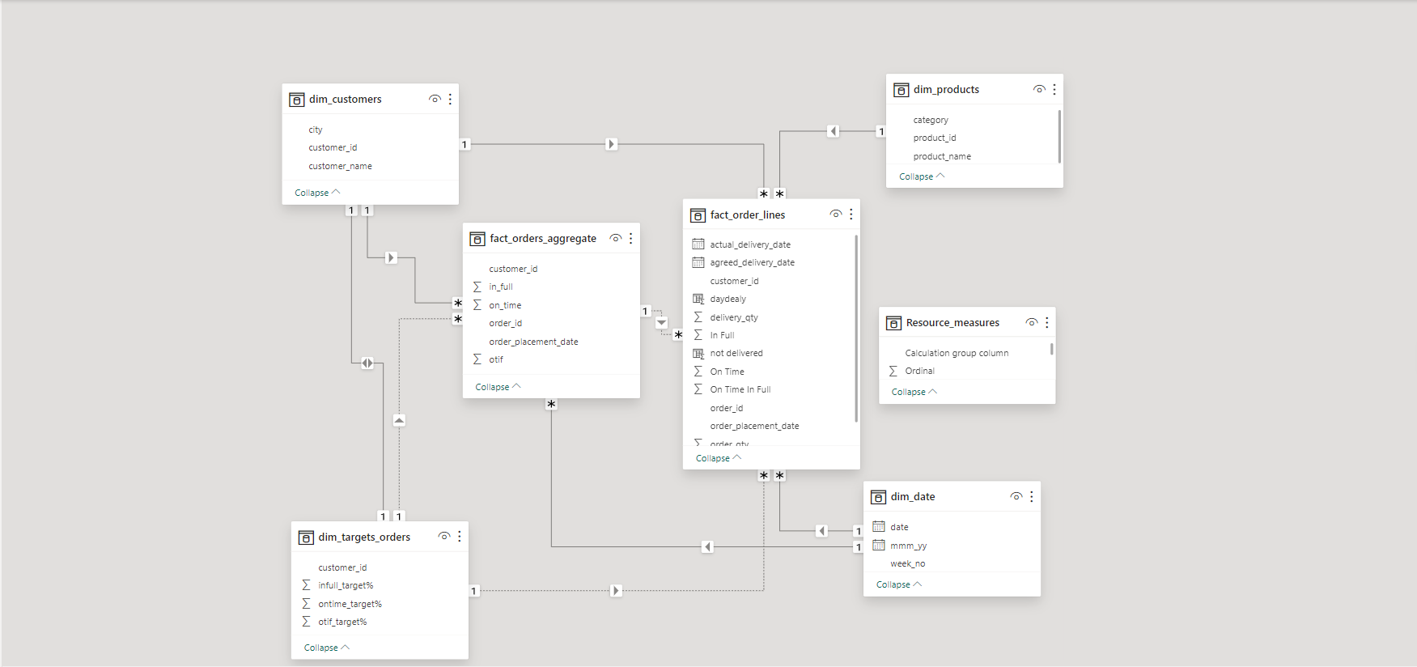
Data Mode

Slide 4
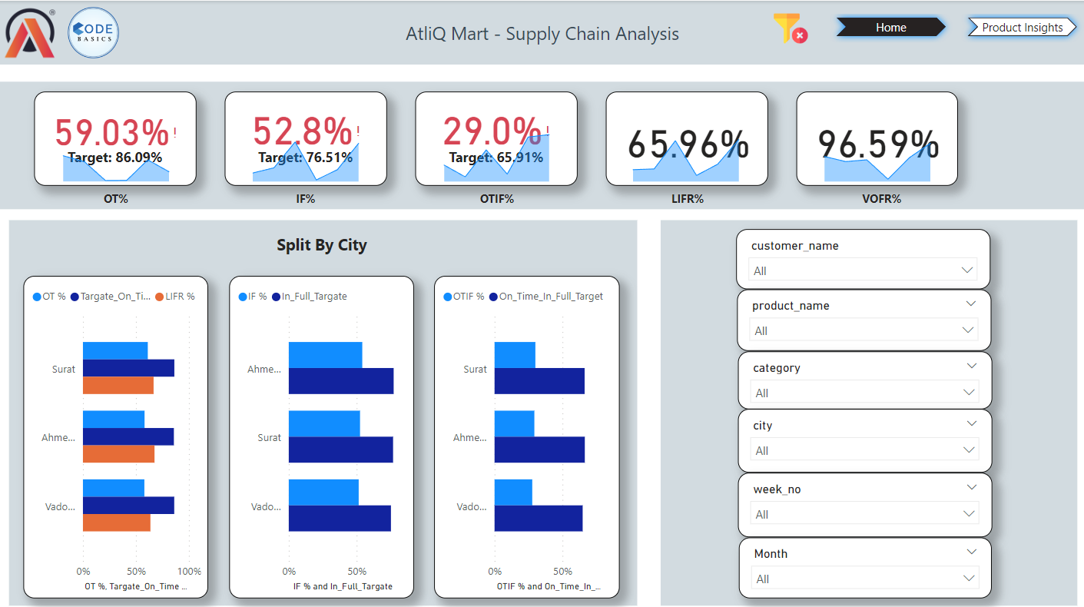
Dashboard

Slide 5
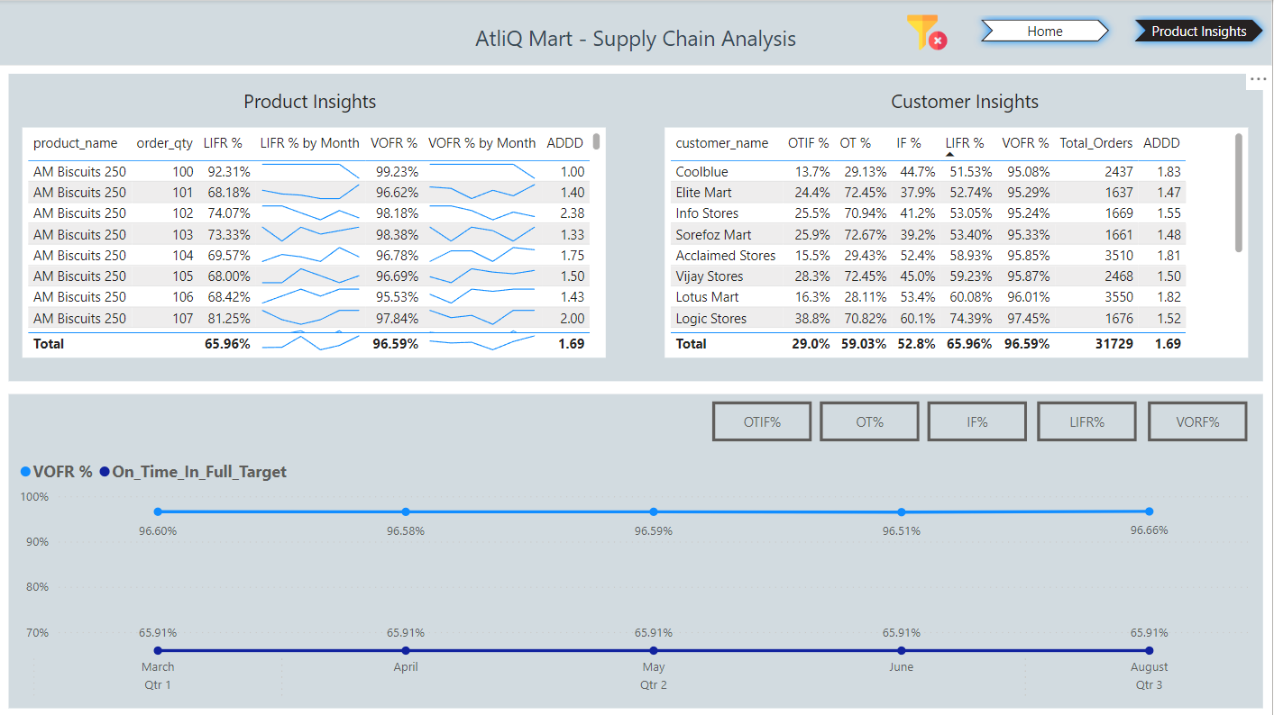
Dashboard

Slide 6
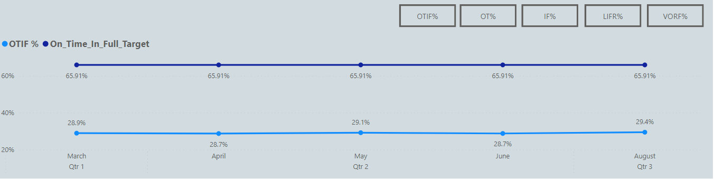
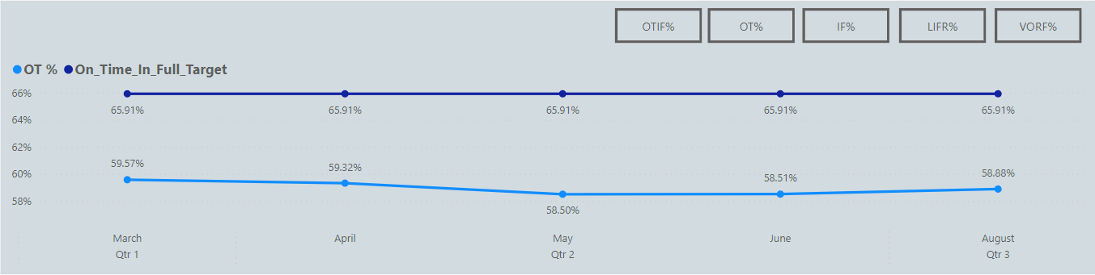
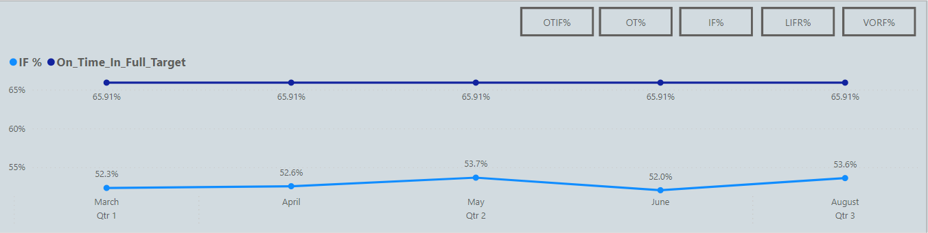
OT, IF, OTIF with respect to the targets
We can see that the metrics like OT, IF, OTIF are below the target values There is also some drop in Day-on-Day, Week-on-week, Month-on-month change for some metrics

Slide 7
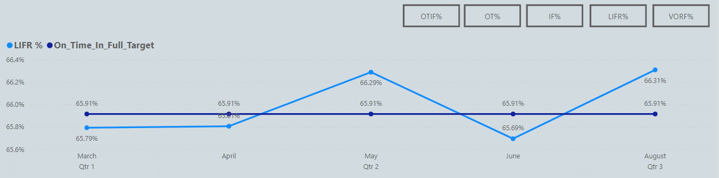
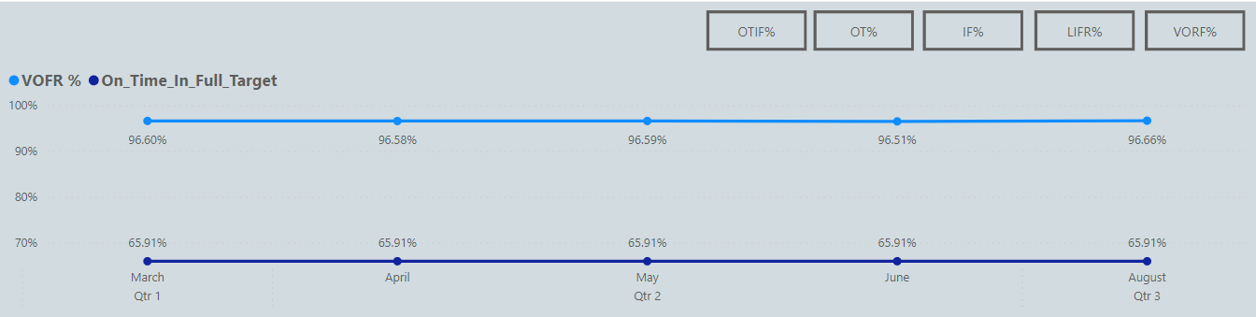
LineFIll Rate and Volume Fill Rate:
Line Fill Rate is 65.96% and Volume Fill rate is 96.59%. While there is an increase in day-on-day and month-on-month change, there is a decline in week-on-week change.

Slide 8
Recommendations
Acclaimed Stores, Cool blue , Elite Mart, Info Stores, Lotus Mart, Sarfaroz Mart, Vijay Stores needs to be focused as they have comparably least values of OT%, IF%, OTIF%.
Among the customers having OT% far less than target, most of the orders are delayed by 1 or 2 days.
As the VOFR% is above 90 % for all the cities and most of the customers, the quantity unable to be delivered is less than order quantity.
Among the customers having least LIFR, diary products have comparatively least value, so the inventory needs to be optimized according to the demand of diary products.
Irrespective of the number of orders in any month, the average number of lines per each order is around two. i.e customers order 2 categories of product’s on average.

Slide 9
conclusion
Focus on customers with the lowest OT%, IF%, and OTIF% to improve order fulfillment efficiency.
Address order delays, as most occur within 1-2 days for customers with low OT%.
Maintain high VOFR% (above 90%) while minimizing undelivered quantities.
Optimize inventory for diary products, as they have the lowest LIFR values among customers.
Consider that customers, on average, order two categories of products per order, aiding demand forecasting.
Use these insights to enhance supply chain performance, improve service levels, and optimize inventory management.

